Slide 1
CSC 4370: Project 4
PrepaidCarking
Leader: SingYu(April)Yu
Eric Oh, Gayoung (Anna) Kim, Vincent Lee

Slide 2
Scrum Development Methodology
Agile framework built for developing delivering and sustaining complex products
Created a design that outlined the goals of our project
Created list of roles, tasks, dates, protocols
Assigned each member a role and task that had the use certain requirements based on provided project detail
Benefits:
Developed at an efficient rate
Allowing more time to fine tune and fix any bugs or issues
Provided more independence
Allowing members to have more creative freedom while also staying within project guidelines
Organization through use of issue orders and progress check up
Notes:
eric

Slide 3
MVC Development Guide
Used provided MVC framework to model our application
Utilized php throughout the project to view and model our project
Assisted with distributing tasks and connecting database to sites
Helped explain the flow of interactions from page to page
Notes:
eric

Slide 4
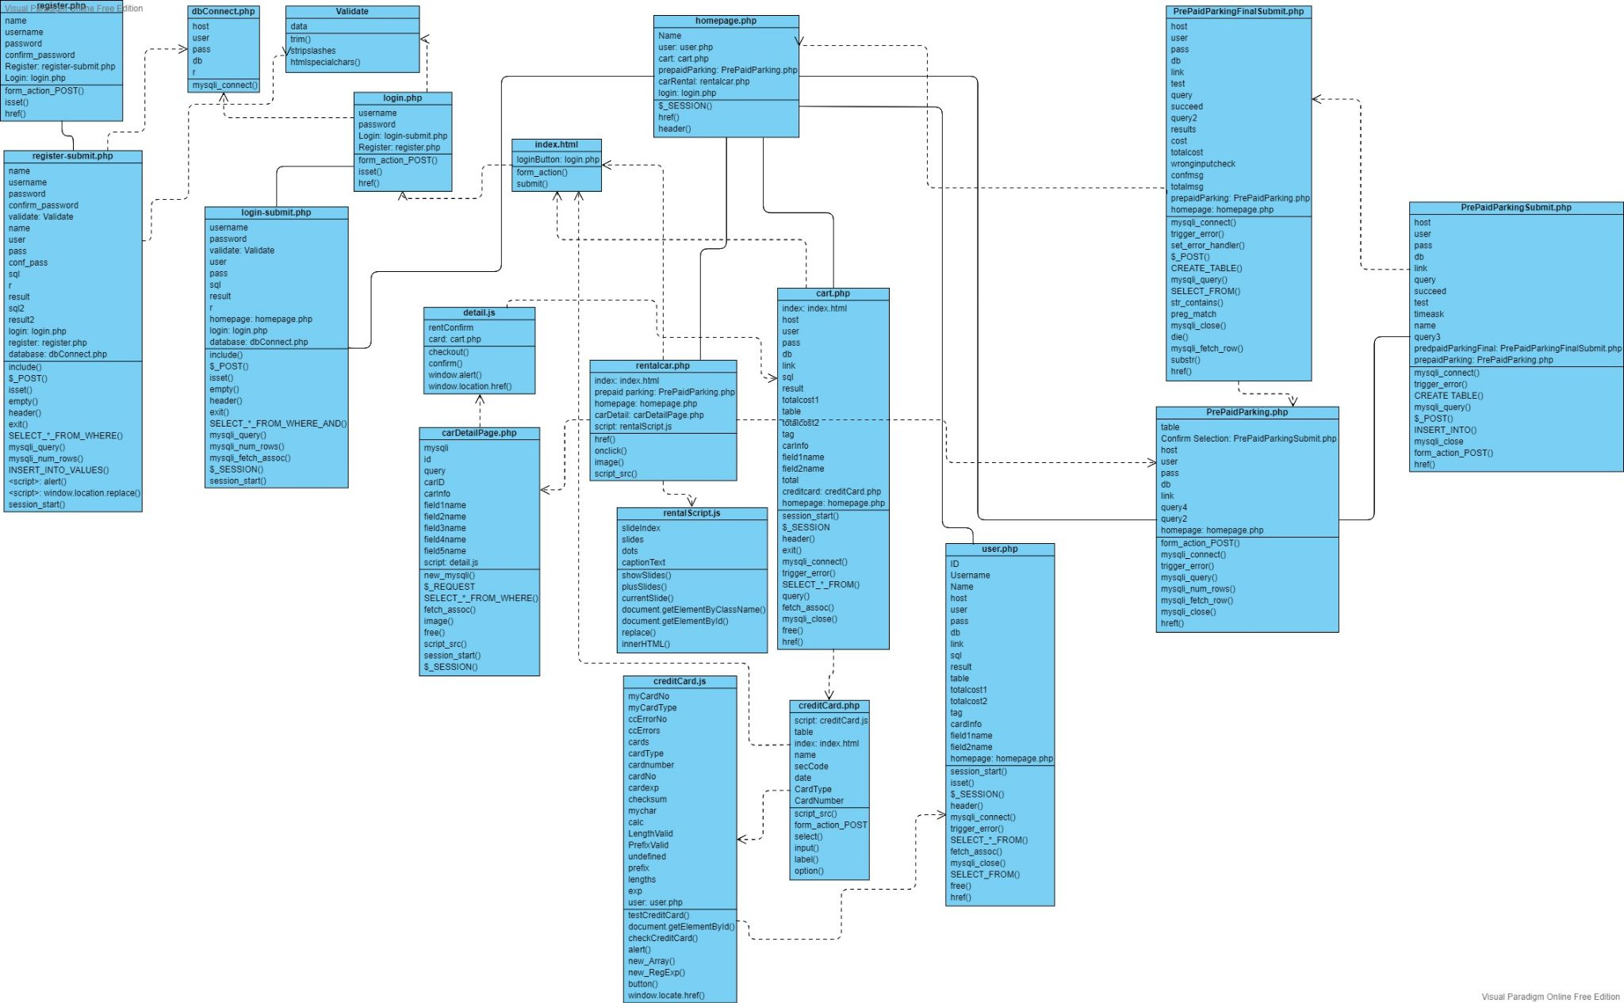
UML
Notes:
anna

Slide 5
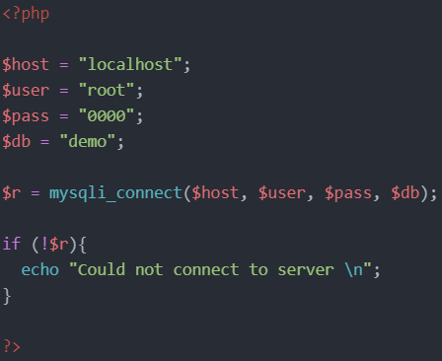
dbConnect.php
A file to connect to the database that will be used during the login page and register page
Notes:
anna

Slide 6
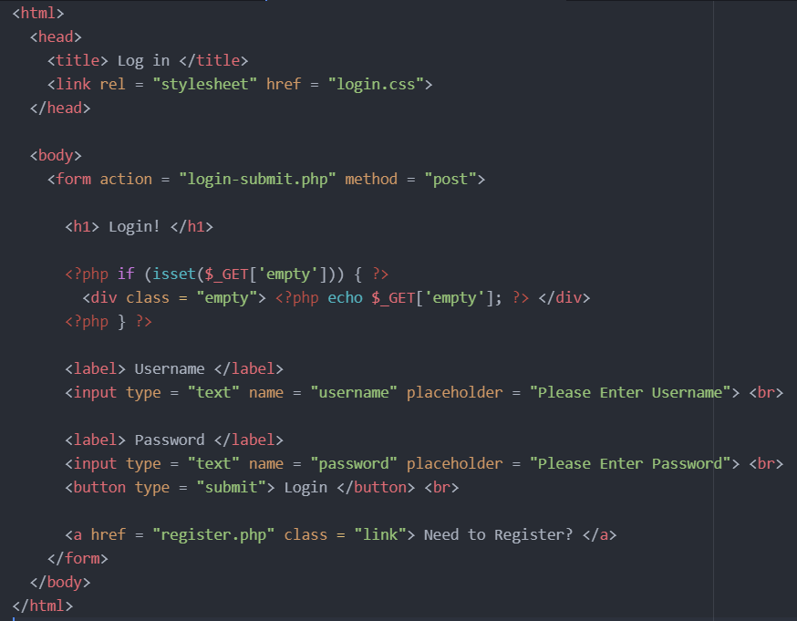
login.php
Used form tag to take in 2 inputs: username and password
Sends data to login-submit.php
Hyperlink to redirect to register.php if not registered yet
Div to display the error message to the user when they are missing something
Notes:
anna

Slide 7
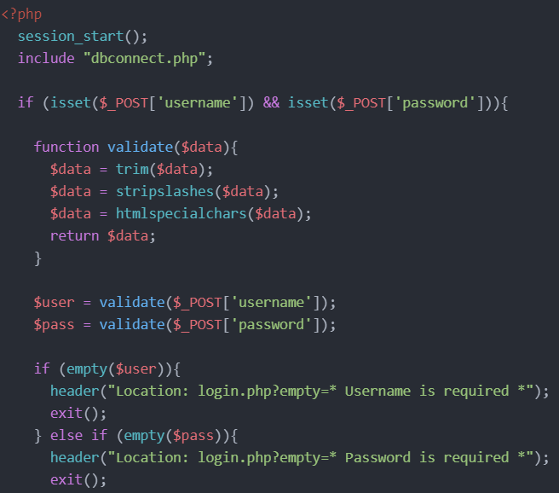
login-submit.php
Includes dbconnect.php to include the database to fetch the user’s data
Calls function validate() for username and password to remove the predefined characters in order to not cause error while reading data
If username and / or password are empty, relocate the user back to login page with the error message of what is missing that will show in div empty
Notes:
anna

Slide 8
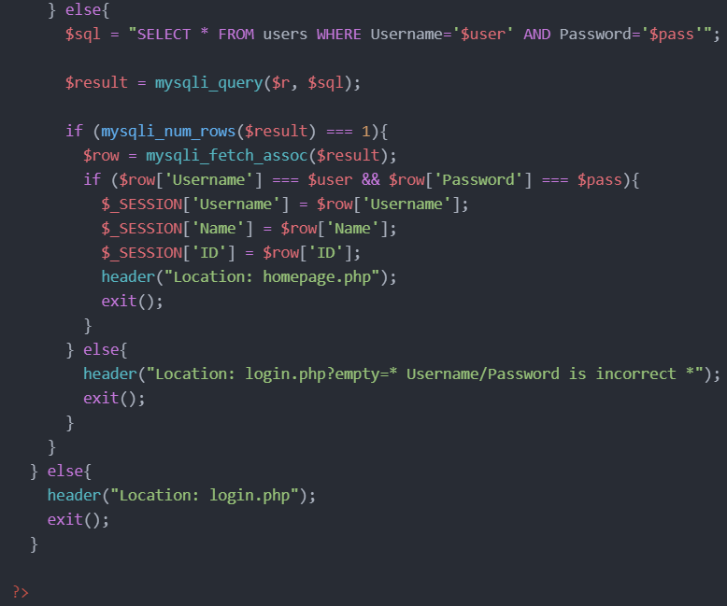
Login-submit.php (continued)
If username and password are not empty, perform mysqli_query() on $sql and $r from the dbConnect.php
By using mysqli_num_rows() and mysqli_fetch_assoc(), check if the username and password are valid and matching
If they are, redirect user to the homepage
If they are not, redirect user to login.php with error message that will show in div empty
Notes:
anna

Slide 9
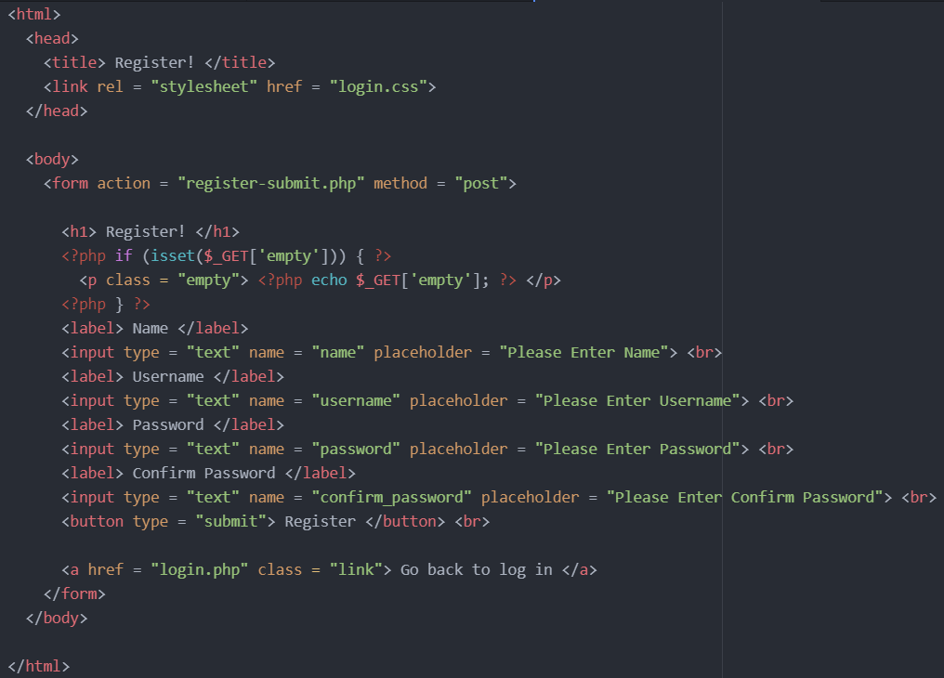
register.php
Used form tag to take in 4 inputs: name, username, password, and confirm password
Sends data to register-submit.php
Hyperlink to redirect to login.php if already registered
Div to display the error message to the user when they are missing something
Notes:
anna

Slide 10
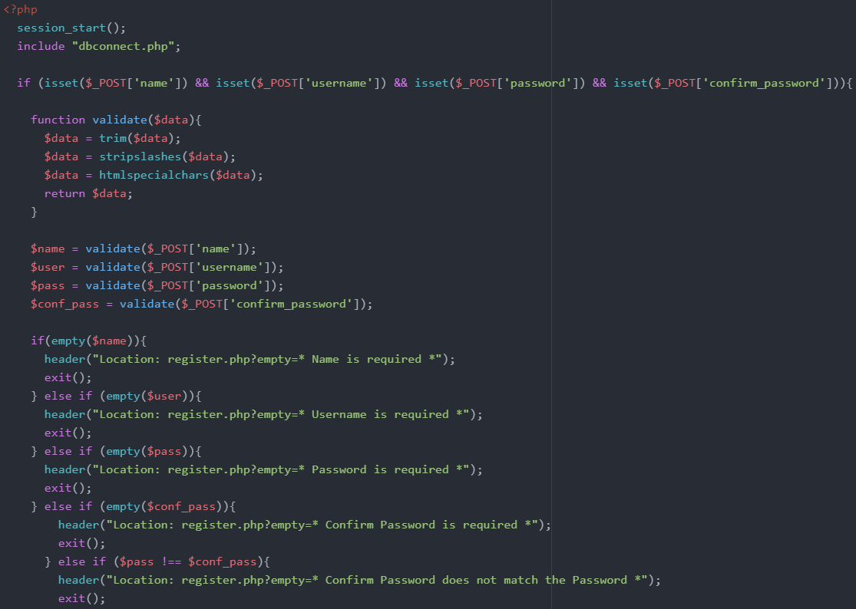
register-submit.php
Basically the same operation as login-submit.php
Includes dbconnect.php to include the database to fetch the user’s data
Calls function validate() for name, username, password, and confirm password to remove the predefined characters in order to not cause error while reading data
If any of the fields are empty, relocate the user back to login page with the error message of what is missing that will show in div empty
Notes:
anna

Slide 11
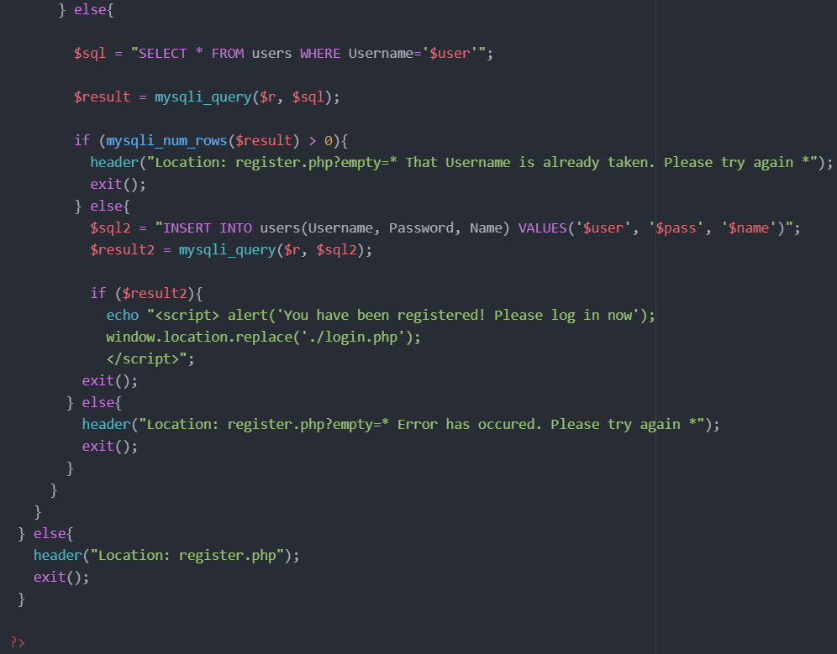
register-submit.php (continued)
If fields are not empty, perform mysqli_query() on $sql and $r from the dbConnect.php
By using mysqli_num_rows() and mysqli_fetch_assoc(), check if the username is valid
If username is already taken, it redirects user with error message
If not, go through mysqli_query() on $sql2 and $r and if $result2 is true, redirect user to login page with success message
If $result if false, redirect user to register.php with error message
Notes:
anna

Slide 12
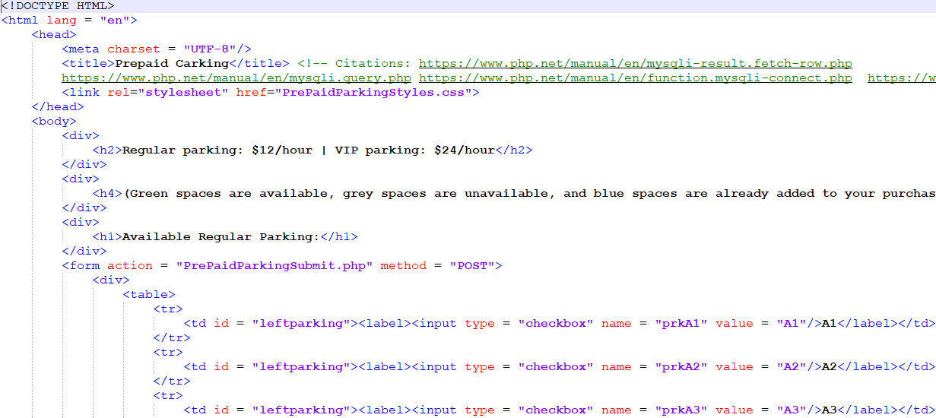
PrePaidParking.php
For the parking rental page, the parking spaces are represented using tables inside the PrePaidParking.php file.
Each cell of the table contains a checkbox that when checked, will POST the name of the parking space to PrePaidParkingSubmit.php .
Notes:
vincent

Slide 13
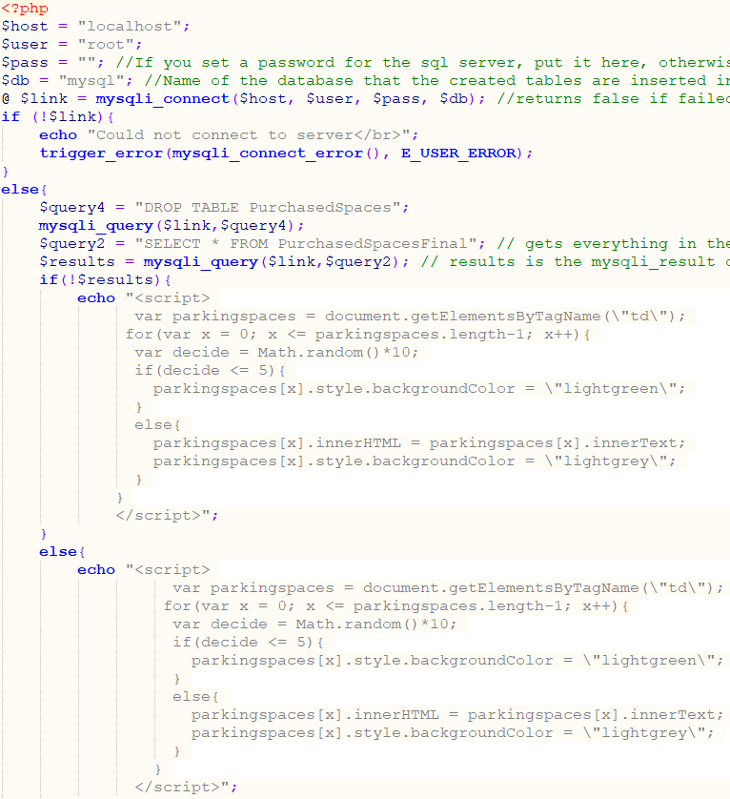
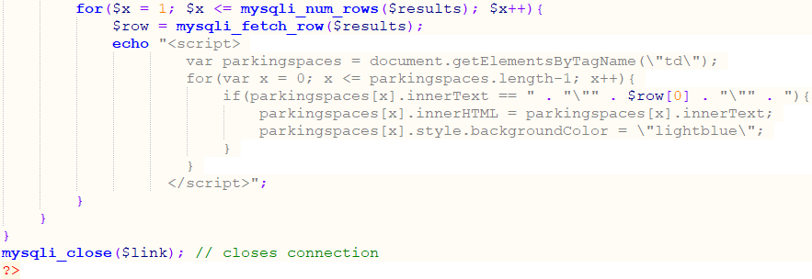
PrePaidParking.php (continued)
There is php code in PrePaidParking.php that connects to the database, and checks to see if there are any parking spaces that the user already chose.
If there are no parking spaces that the user has already chosen, then which parking spaces that are available will be randomized on each page refresh.
If there are already spaces the user has chosen, then the spaces will first be randomized, and then each space that the user already chose will be marked so that it cannot be chosen twice.
Notes:
vincent

Slide 14
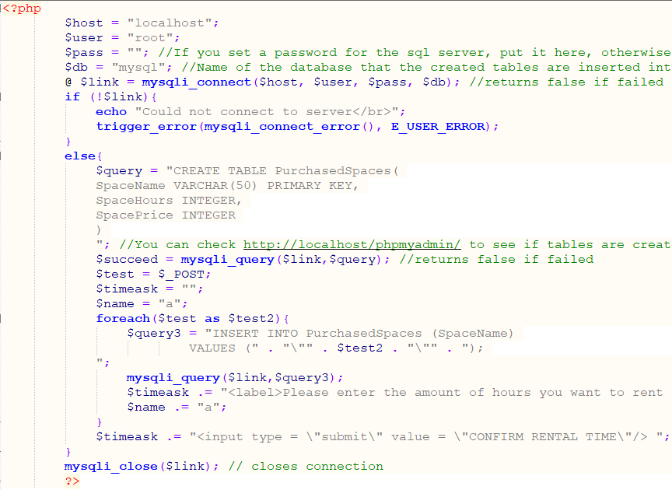
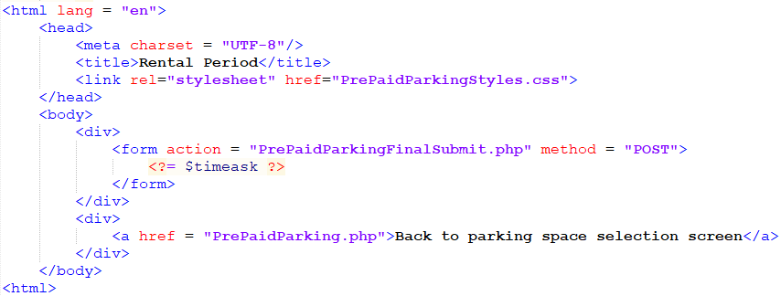
PrePaidParkingSubmit.php
Once the selected parking space names are submitted to PrePaidParkingSubmit.php, a temporary table is created in the database, and each parking space name is inserted into this table for later use.
An empty string is then created, and the names are used to build several html statements which are then inserted into an html form, so the user can specify how many hours they want to rent each parking space for.
This information is then POSTed to PrePaidParkingSubmitFinal.php
Notes:
vincent

Slide 15
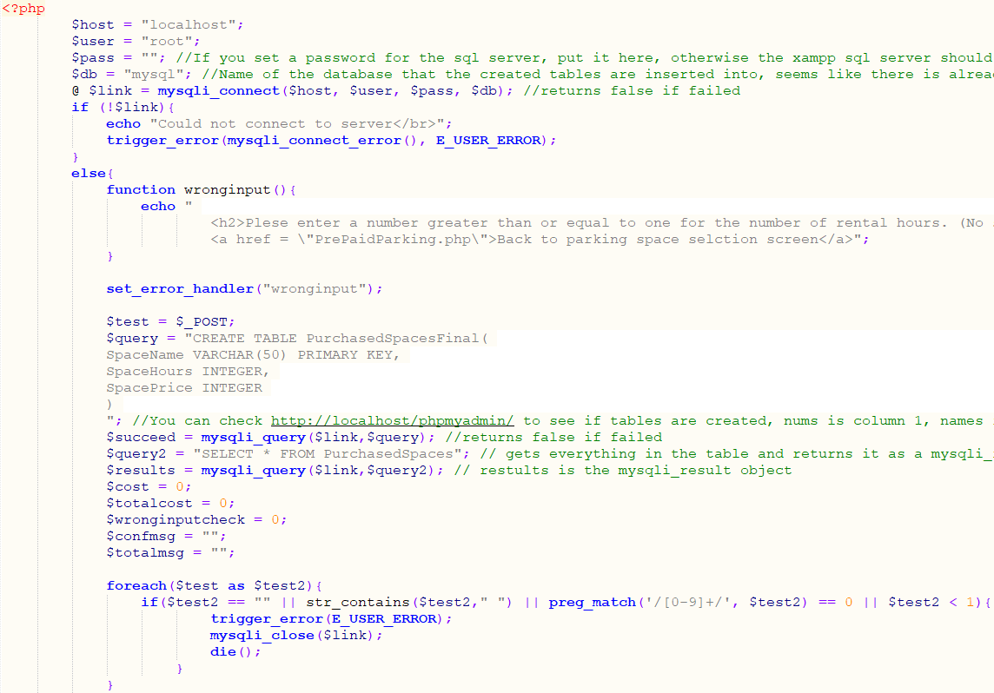
PrePaidParkingSubmitFinal.php
When PrePaidParkingSubmitFinal.php receives the information for the number of rental hours, it checks to see if there was any incorrect input the the user made, such as leaving spaces blank, inputting letters instead of number, or attempting to rent a space for zero or less hours.
Notes:
vincent

Slide 16
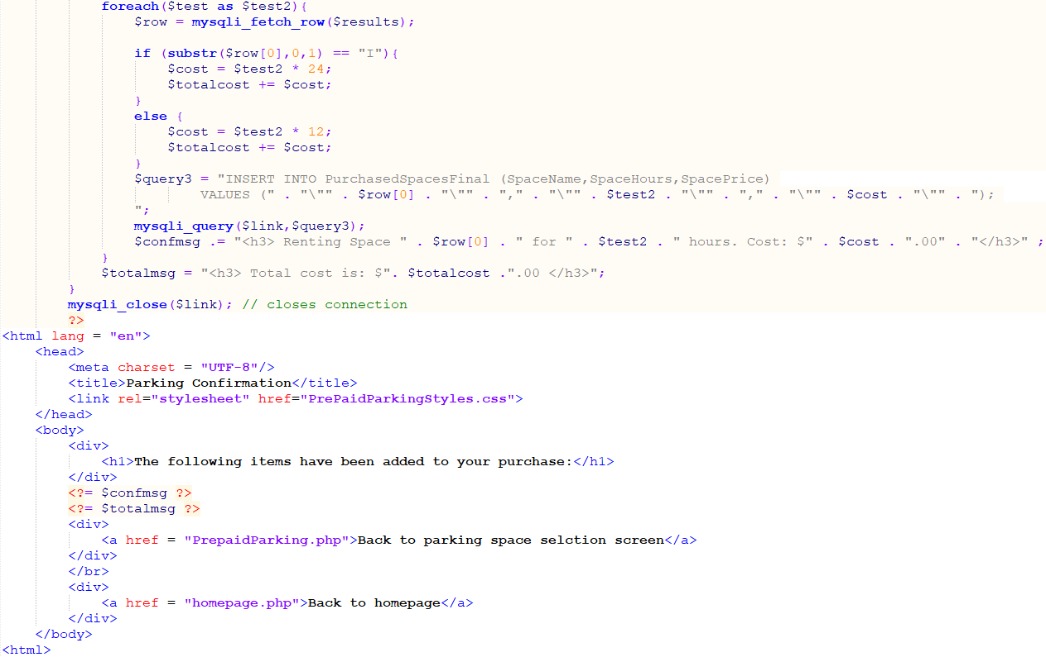
PrePaidParkingSubmitFinal.php (continued)
If all of the user input was correct, then the cost of each parking space is calculated based on the number of rental hours, and whether the space is a VIP space or not.
The space name is pulled from the temporary table, and it is inserted into a final table in the database, along with the rental hours and cost of the space.
Several messages created during this time, which inform the user of information about the spaces, such as names, rental hours, cost, and total cost.
Notes:
vincent

Slide 17
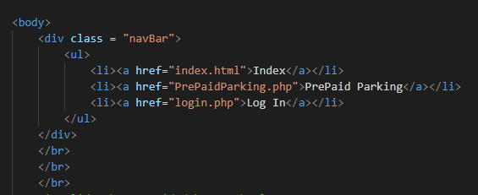
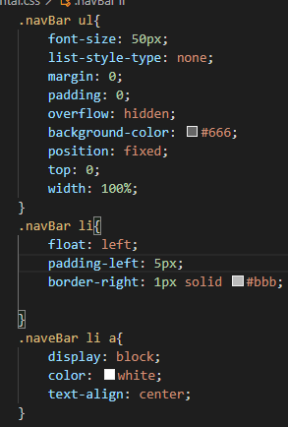
RentalCar.php -
Nav Bar
Allows for easy transition between pages
Used unordered list format to create tabs
Linked to all pages through project
Used CSS to style and align
Notes:
eric

Slide 18
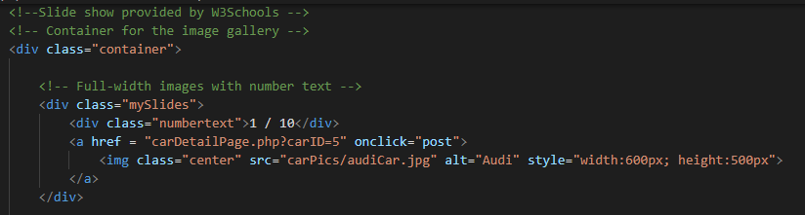
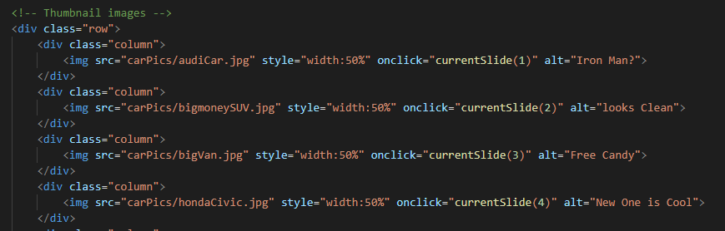
RentalCar.php -
Slide Show
Added slideshow to present all vehicle options
Allows for easy use for picking choices
Main Image is clickable which sends the user to look at the vehicle’s detail
Next and Back arrow for fun navigation
Notes:
eric

Slide 19
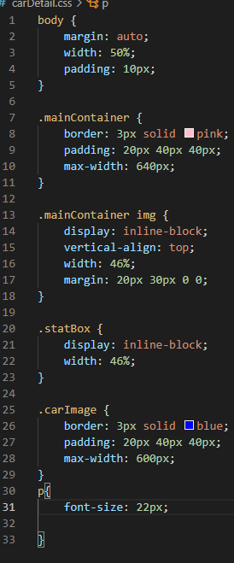
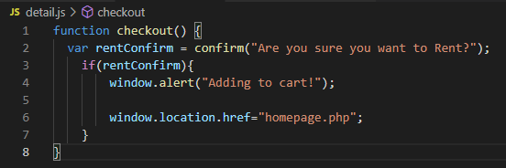
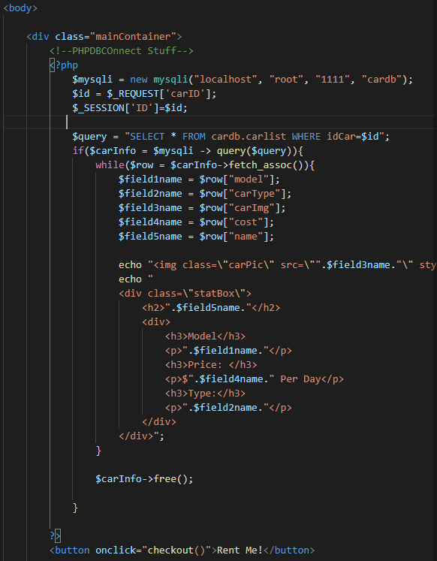
carDetailpage.php
Used Session to transfer car ID to cart page
Used mySQL to manage database which contained car’s detail
Model
Name
Cost
Img
Type
Used PHP and CSS to display details in a presentable manner
Notes:
eric

Slide 20
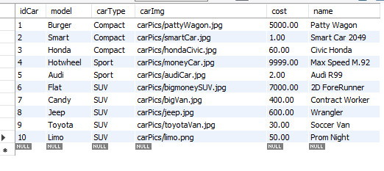
Car Database
Utilized mySQL to manage, organize, and filter vehicle data
Each car is given a special ID which is used throughout the project to pull data for specific cars
Cost of each car is set to a decimal datatype to maintain money based format
Each vehicle is also given a unique name
Notes:
eric

Slide 21
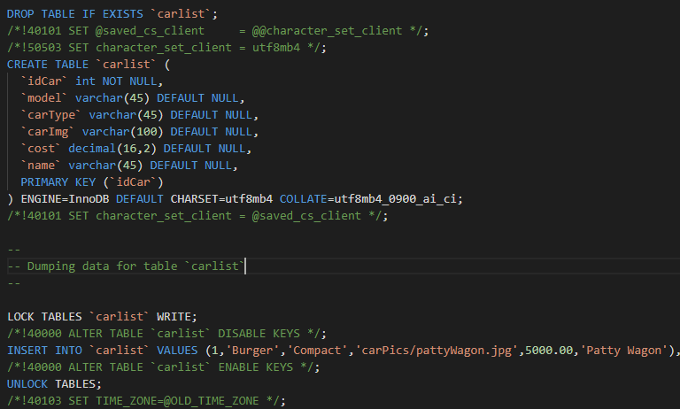
Car Database -
In ‘code’ format
DROP TABLE deletes table if already exists
Creates new table named carlist with set columns
idCar - Primary Key
Model
Cartype
carImg
Cost
Name
Created in MySQL
Notes:
eric

Slide 22
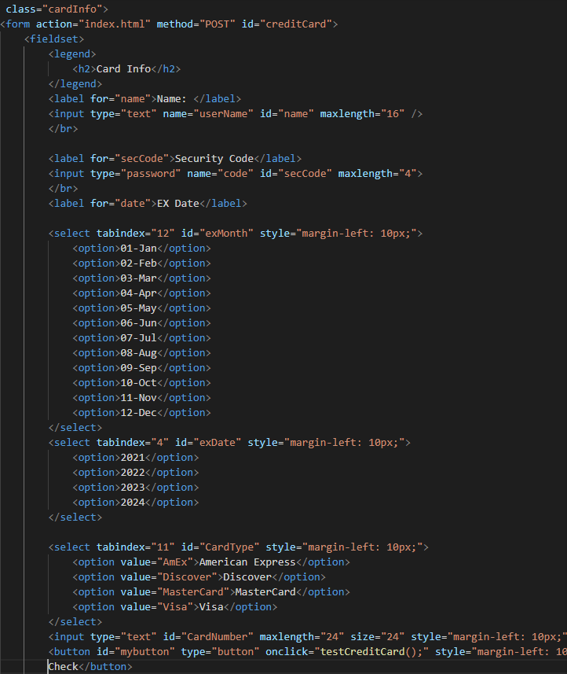
creditCard.php
Utilized fieldset and legend to provide clean UI for entering card information
Used drop down menus for requesting card expiration date
Input text boxes for password as well as Card holder’s name
Finally used drop down to check different types of cards which ran the “testCreditCard()” Function
Notes:
eric

Slide 23
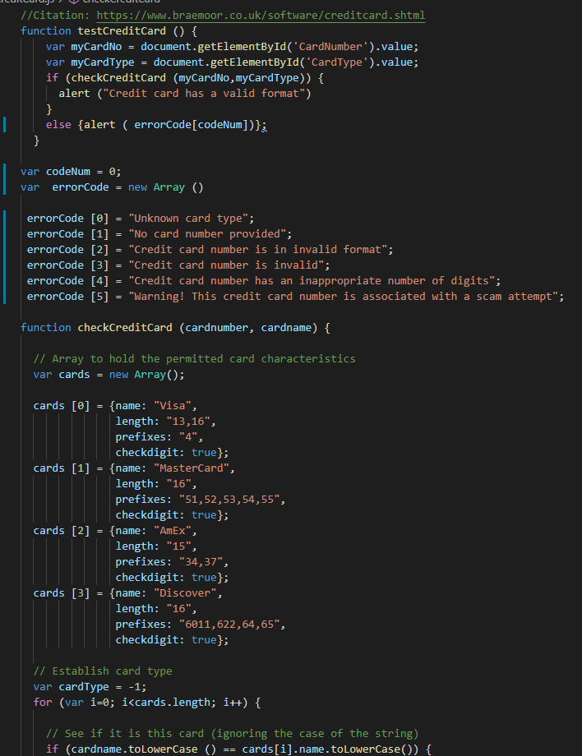
creditCard.js
Grabbed needed data from website to check card validation
Had several error codes prepared for different outcomes
Used provided info to check validity of each card data
Notes:
eric

Slide 24
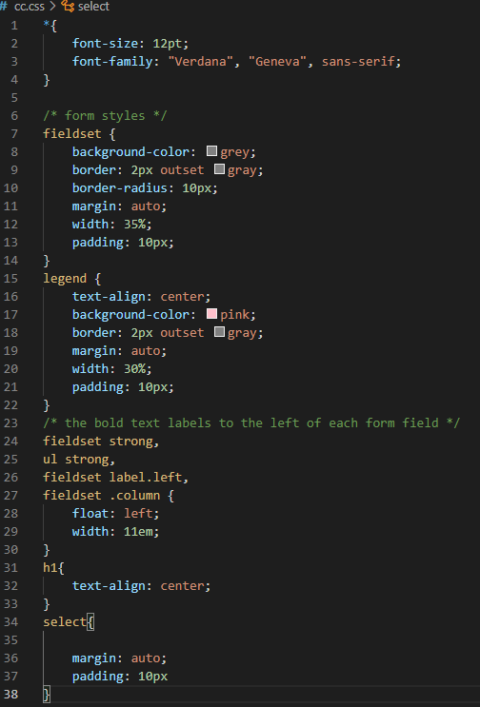
Cc.css
Added vibrant color theme to provide welcoming UI to user
Used float to organize containers to look presentable
Margin and padding configurations to add fine details for better alignment
Notes:
eric

Slide 25
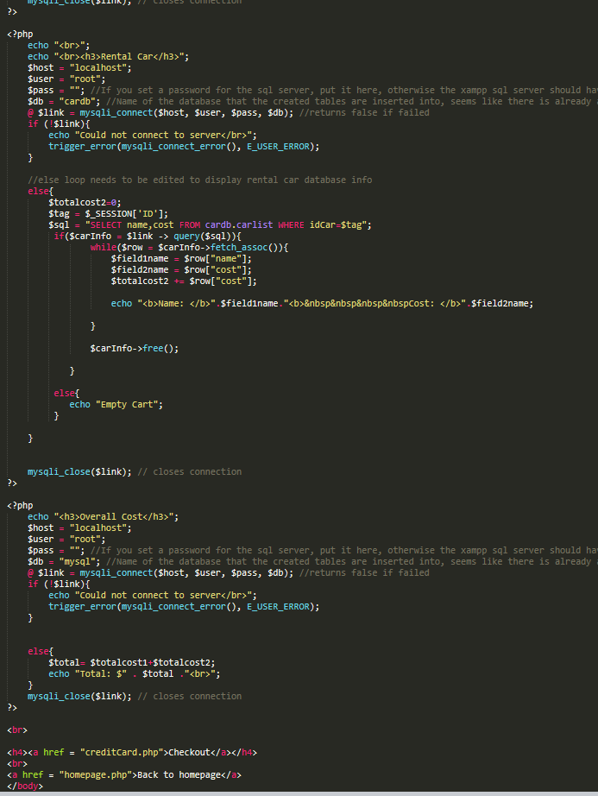
Cart
Called rows and columns for parking space and rental car
Used while loops to loop through and display names and information and total up costs
If nothing, shows: Empty Cart
Has a total cost for the two sections added together
Notes:
april

Slide 26
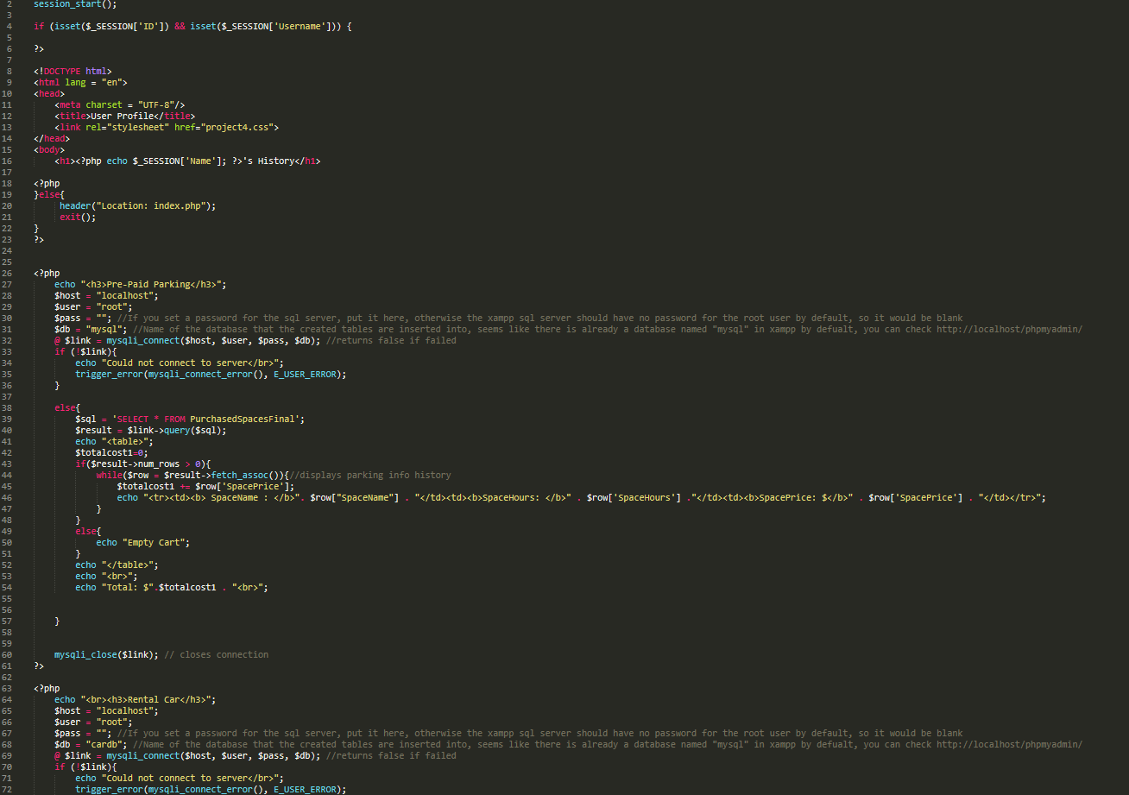
User History
Uses while loops to show information and run through the columns and rows
Similar to cart, displays the costs, including a total cost for each section
Notes:
april

Slide 27
Test Case
Test Plan
Trial and Error
Worked on code to best abilities then tested and made adjustments over each test
Tracking
Observing and Correcting
Took note of where errors occurred and made corrections where possible
Bugs
When going to use the back arrow on some pages it would bug out and give an error due to not having certain ID codes
Had an issue with a str_contains function, was not valid on some platforms
If the user had chosen several parking spots and entered an incorrect input would still count the spots as taken
Is fixed in final version
Notes:
vincent

Slide 28
Demo
Github: https://github.com/oEriic/prepaidCarking
Notes:
april

